Slide 1

Object Oriented Programming
Prof. Varsha Dange

Slide 2
Introduction
What is Object Oriented Programming (OOP)?
The need of OOP
Characteristics of OOP

Slide 3
What is Object Oriented Programming (OOP)?
OOPs is a programming paradigm that based on the concept of “object” and “classes”.
Object-oriented programming is a method used for designing a program using classes and objects.
object-oriented programming languages such as C++, Java, Python , JavaScript, Ruby, Perl, Smalltalk etc.

Slide 4
The Need of OOP
Object oriented programming is essential for following reasons
1) To represent real life entities of problems in system design.
2) To ensure reusability and extensibility of modules.
3) Design modules that are tolerant to changes in future.
4) Increase software productivity and reduce software development cost.
5) Increase quality of software developed.
6) Manage time schedule.
7) To develop secure software (i.e. Security).

Slide 5
Contd…
8) To develop portable software (i.e. Portability )
9) Easy to integrate (i.e. Integrity).
10) To develop user friendly software.
11) To develop accurate Software.
12) Easy maintain.
13) Code readability is more.

Slide 6
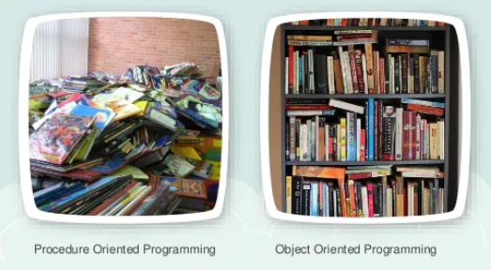
Contd..
OOP was developed because limitations were discovered in earlier approaches to programming.

Slide 7
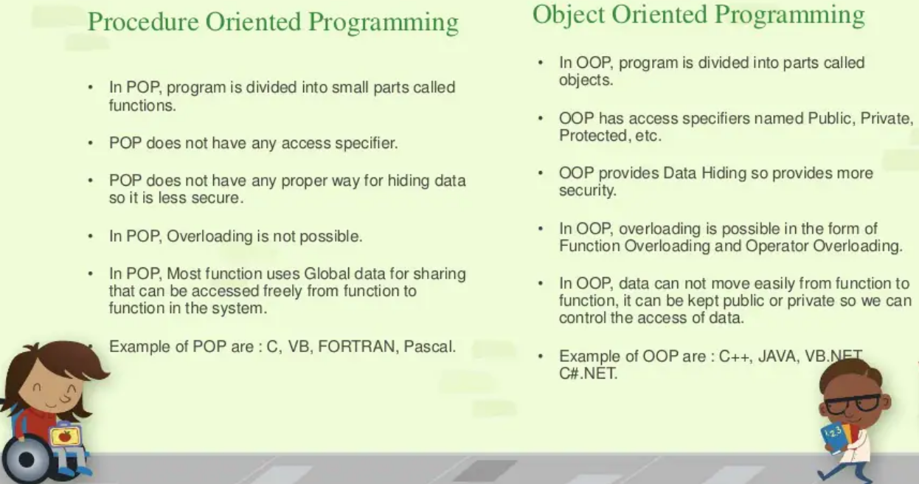
Contd..

Slide 8
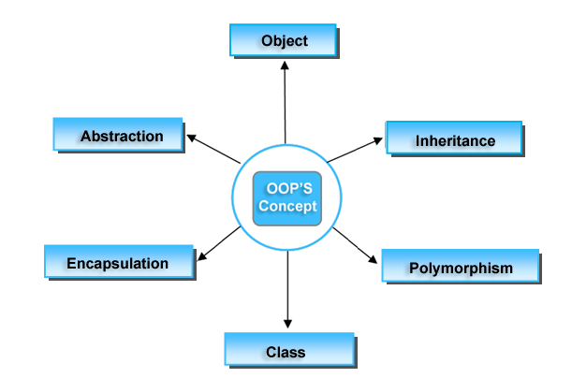
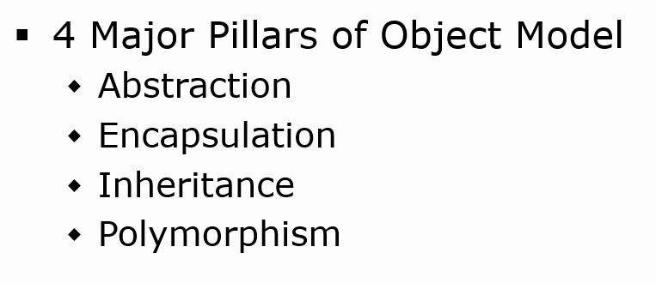
Characteristics of object-oriented languages

Slide 9
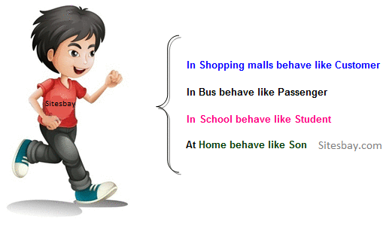
Polymorphism
Polymorphism refers to the ability of OOPs programming languages to differentiate between entities with the same name efficiently.
One thing-Many forms

Slide 10
Inheritance
Inheritance is an important pillar of OOP(Object Oriented Programming). It is the mechanism in java by which one class is allowed to inherit the features(fields and methods) of another class.
Super Class: The class whose features are inherited is known as super class(or a base class or a parent class).
Sub Class: The class that inherits the other class is known as subclass(or a derived class, extended class, or child class). The subclass can add its own fields and methods in addition to the super class fields and methods.

Slide 11
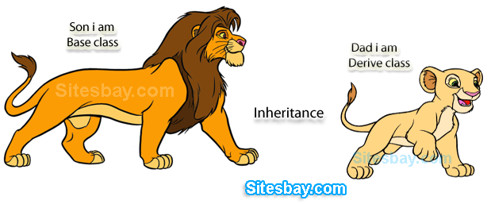
Inheritance

Slide 12
Inheritance
Reusability: Inheritance supports the concept of “reusability”, i.e. when we want to create a new class and there is already a class that includes some of the code that we want, we can derive our new class from the existing class.
By doing this, we are reusing the fields and methods of the existing class.

Slide 13
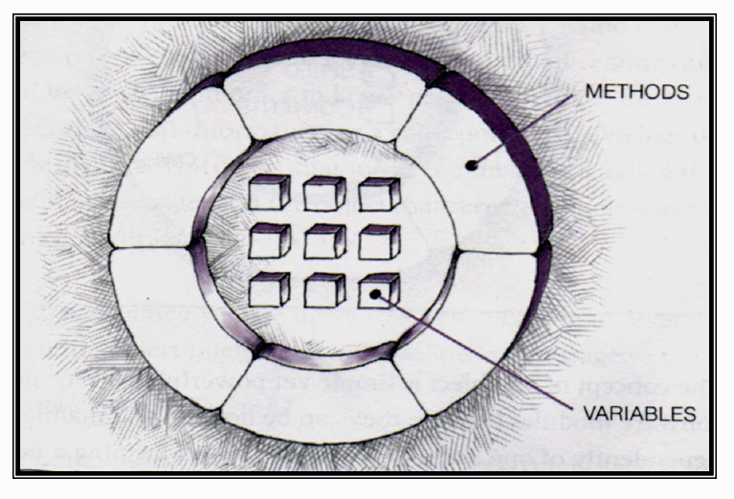
Encapsulation
Encapsulation is defined as the wrapping up of data under a single unit.
It is the mechanism that binds together code and the data it manipulates.
Another way to think about encapsulation is, it is a protective shield that prevents the data from being accessed by the code outside this shield.

Slide 14
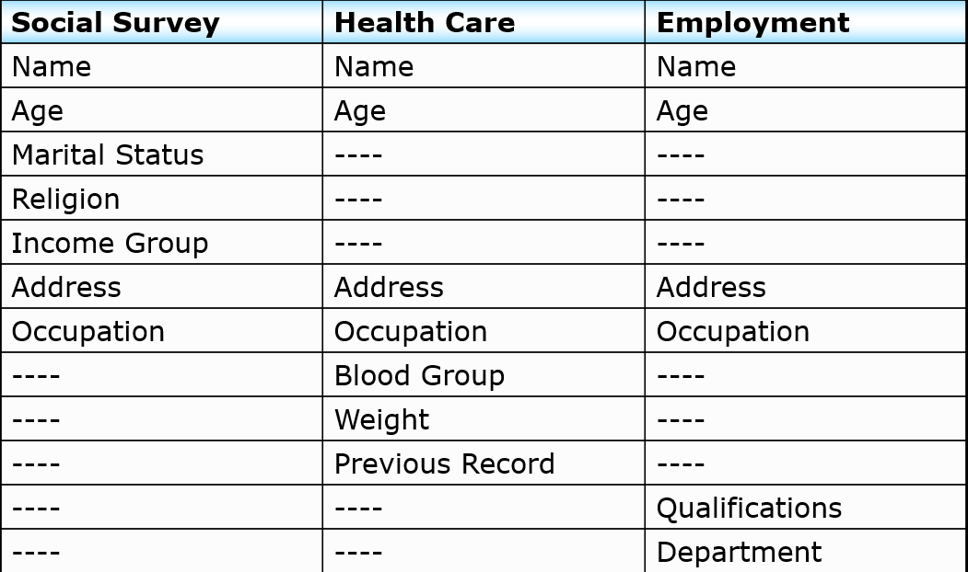
Abstraction
Data Abstraction is the property by virtue of which only the essential details are displayed to the user.
The trivial or the non-essentials units are not displayed to the user. Ex: A car is viewed as a car rather than its individual components.

Slide 15
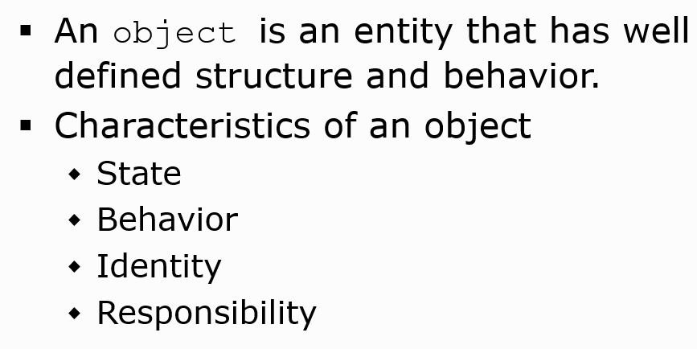
Object

Slide 16
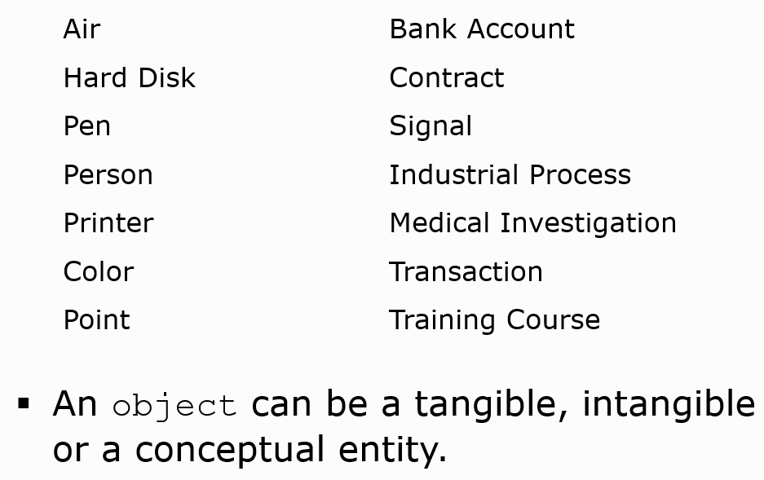
Examples of Object

Slide 17
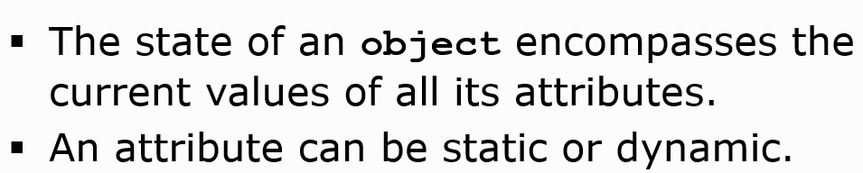
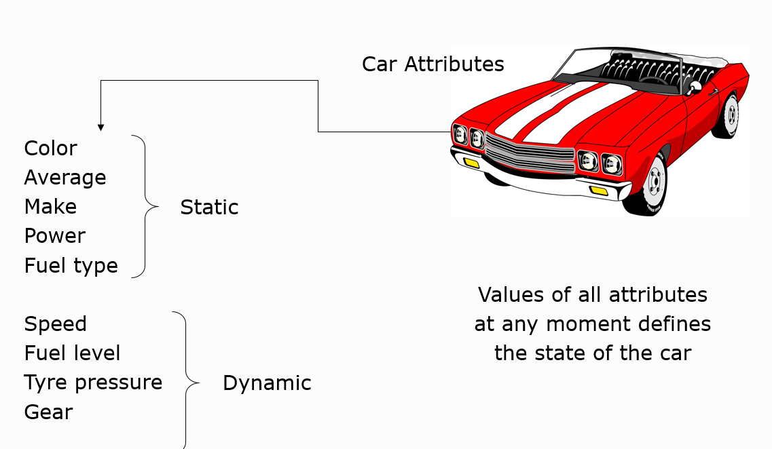
State of an object

Slide 18
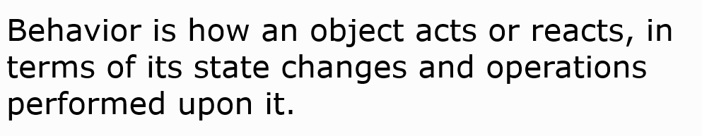
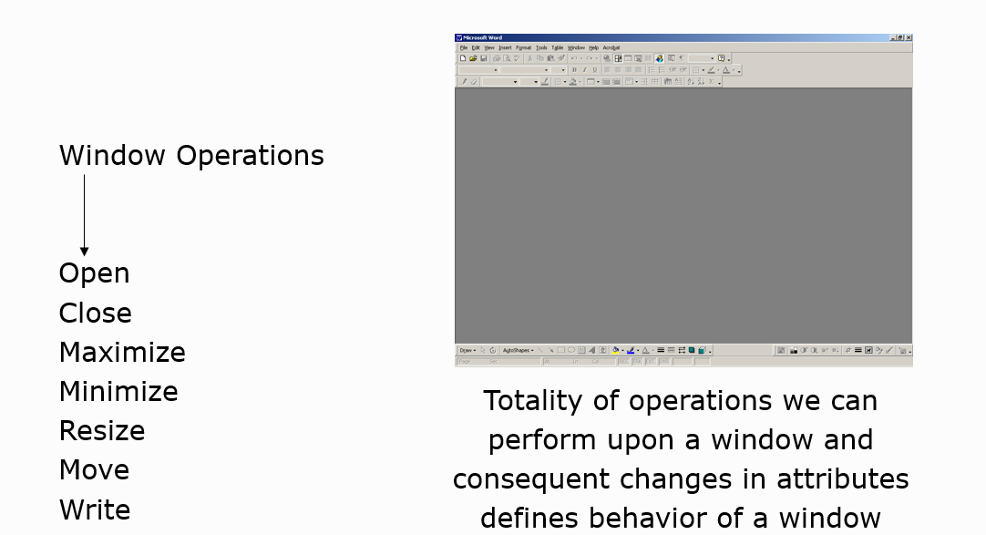
Behavior of an Object

Slide 19
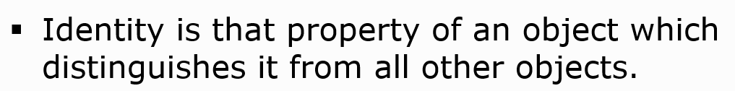
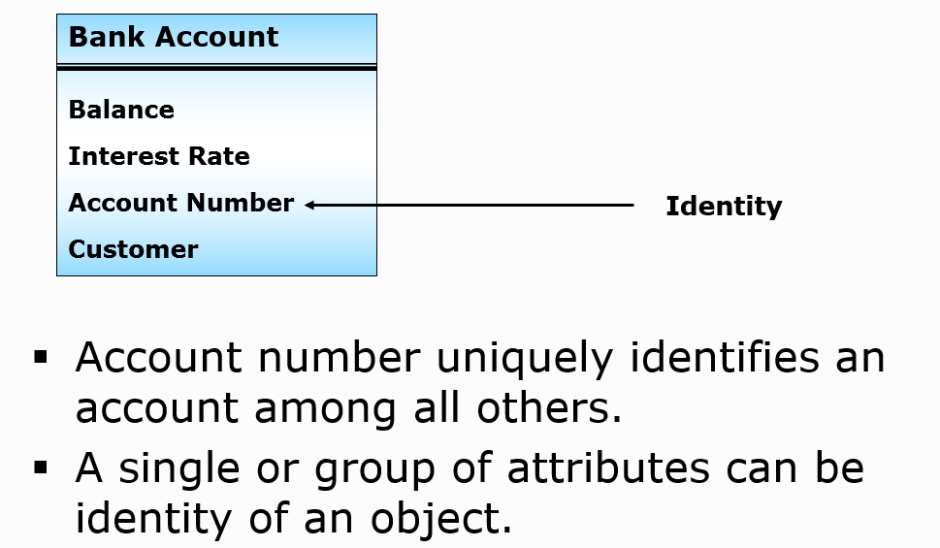
Identity of an object

Slide 20
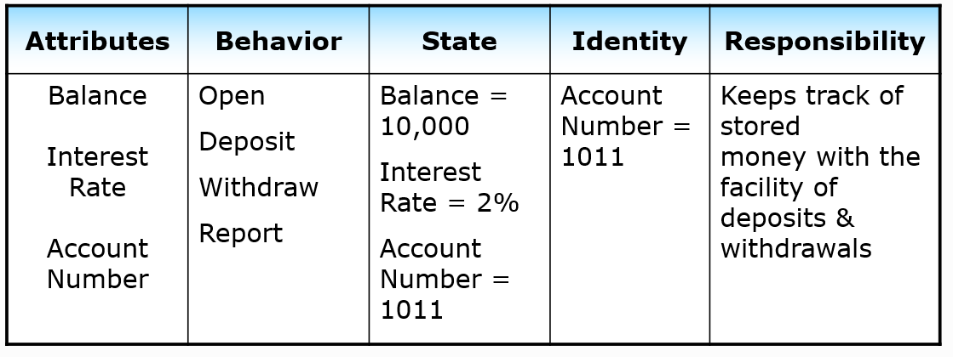
Bank Account Object

Slide 21
Classes and Objects
A class is a template for an object, and an object is an instance of a class.
Class is blueprint of an object.
Class description of variables and method.
Class is means to achieve encapsulation
no memory is allocated for class ,it is logical
Object is run time entity: memory get allocated to object in RAM(heap memory)
A class is declared by use of the class keyword.

Slide 22
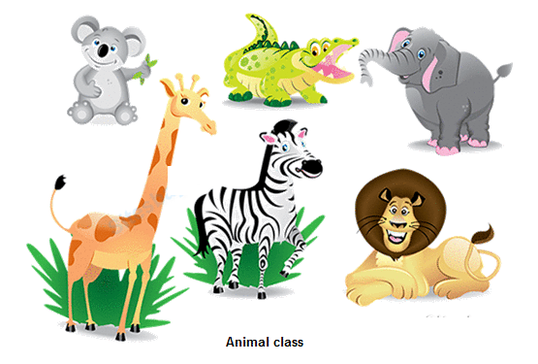
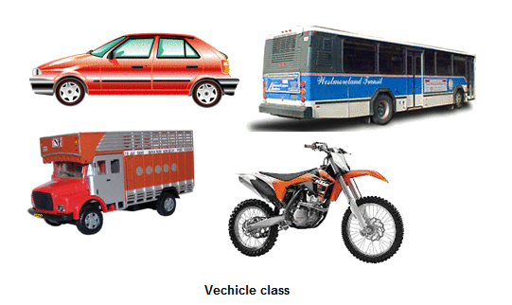
Classes and Objects

Slide 23
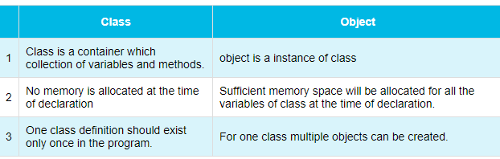
Difference between Class and Object

Slide 24
Contd..
A class is a group of objects which have common properties.
A class in Java can contain:
Fields
Methods
Constructors
Blocks
Nested class and interface

Slide 25
Classes and Objects
A simplified general form of a class definition is shown here:
Data Type
Name of Variable
Return Type
Name of Method
Code
Parameters Passed

Slide 26
Classes and Objects
The data, or variables, defined within a class are called instance variables.
The code is contained within methods.
Collectively, the methods and variables defined within a class are called members of the class.
Example

Slide 27
Classes and Objects
Variables defined within a class are called instance variables because each instance of the class (that is, each object of the class) contains its own copy of these variables.
Thus, the data for one object is separate and unique from the data for another.

Slide 28
A Simple Class
Here is a class called Box that defines three instance variables: width, height, and depth.
As stated, a class defines a new type of data.
In this case, the new data type is called Box.
We will use this name to declare objects of type Box.
It is important to remember that a class declaration only creates a template; it does not create an actual object.

Slide 29
A Simple Class
To actually create a Box object, you will use a statement like the following:
Box mybox = new Box(); // create a Box object called mybox
After this statement executes, mybox will refer to an instance of Box. Thus, it will have “physical” reality.
Each time we create an instance of a class, we are creating an object that contains its own copy of each instance variable defined by the class.

Slide 30
A Simple Class
Thus, every Box object will contain its own copies of the instance variables width, height, and depth.
To access these variables, you will use the dot (.) operator.
The dot operator links the name of the object with the name of an instance variable.
For example, to assign the width variable of mybox the
value 100, we would use the following statement:
mybox.width = 100;

Slide 31
Example
Call the file that contains this program BoxDemo.java, because the main( ) method is in the class called BoxDemo, not the class called Box.

